Slide 1
World Population
Chapter 4 Section 1

Slide 2
Over 7 Billion
Number of people on this Earth

Slide 3
http://video.nationalgeographic.com/video/the-magazine/the-magazine-latest/ngm-7billion/

Slide 4
The Demographic Transition
Demography – study of populations
Birthrate vs. Death rate
Natural increase and migration
Transition – use of birth/death rate to demonstrate change in pop.
Falling death rates
Zero population growth – equal birth and death rate

Slide 5
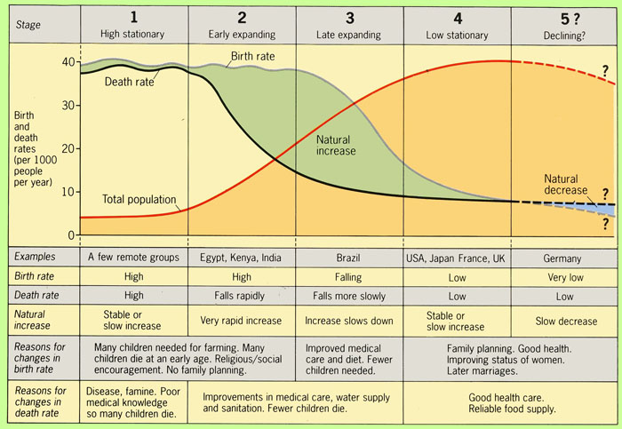
The Demographic Transition Cont.

Slide 6
The Demographic Transition Cont.
Birthrates fallen in parts of Asia, Africa, and Latin America
Families having many children – doubling time of growing population

Slide 7
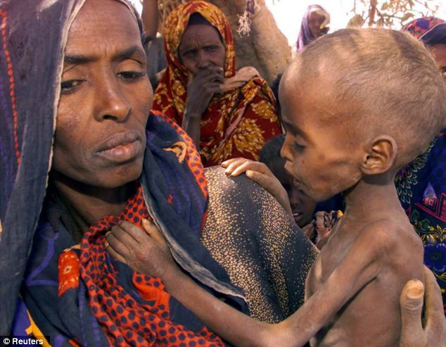
Challenges of Growth
More people means more need for resources
Food production rose in all continents except Africa
Lack of housing, water or clothing in some places
Uneven age distribution

Slide 8
Negative Population Growth
Death rate exceeds birthrate
Difficult to find enough people to keep economy going
Importance of immigration
Concentration in metropolitan areas

Slide 9
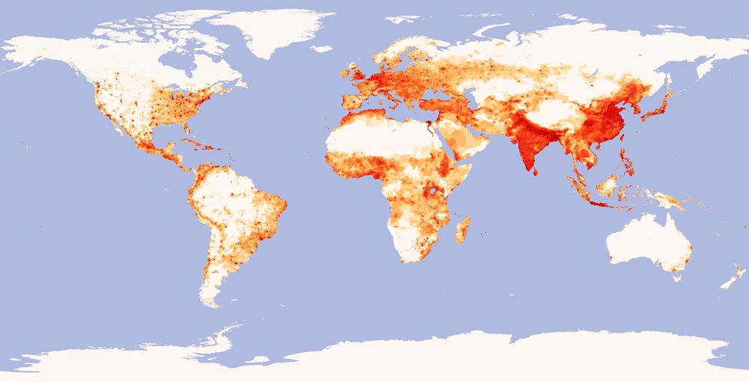

Slide 10
Population Density
Number of people per square mile
Canada – low density
Bangladesh – high density
Bolivia vs Dominican Republic – same pop. different land masses

Slide 11
Population Movement
Urbanization – growth of city populations
Desire to find jobs and better life
Rural population grows but number of farmers doesn’t
Emigration/immigration
Push factors: war, food shortages, ect.
Refugees – fleeing persecution or disasters

