Slide 1
Global Cultures
Chapter 4 Section 2

Slide 2
Stereotypes
With your partner (person at your table) list the classic high school stereotypes
Are they real? Do you fit in any of them?
List other classic stereotypes (dumb blonde, loud Italians, ect)
Are these believable? Why/how are they created?

Slide 3
Elements of Culture
Culture – way of life of a group of people who share similar beliefs and customs
Language, religion, daily life, history, art, government, economy

Slide 4
Language
Key to a culture’s development
Communication, information, values
Local dialects – colloquial terms
Language families – similar roots

Slide 5
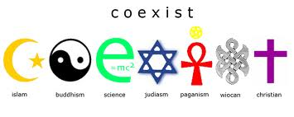
Religion
Vary around the world
Religious differences – source of conflict
Influences aspects of daily life
Religious stories and symbols shape history, paintings, architecture and music

Slide 6
Social Groups
Social classes
Ranked based on wealth, ancestry, education
Ethnic group – people who share a common language, history, place of origin, or combination

Slide 7
Government and Economy
Levels of power: national, regional and local
How a culture utilizes natural resources to meet human needs
Produce, obtain, use and sell goods and services

Slide 8
Types of Government
Spades: Capitalism
Clubs: Socialism
Diamonds: Communism
Hearts: Monarchy
You must have one of each in every group. Within your group decide which form of government is the most effective and why. Use your phones ONLY if you need to look up one of the forms of government.

Slide 9
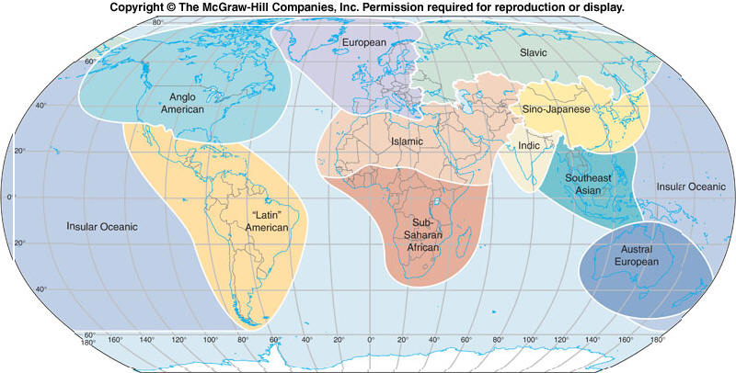
Culture Regions
Countries that share similar economic systems, forms of government and social groups
Histories, art and social groups share similar influences

Slide 10
Cultural Change
New ideas, lifestyles, and inventions
Change within cultures
Cultural diffusion – process of spreading new knowledge from one culture to another

Slide 11
The Agricultural Revolution
Earliest humans were nomads
Finding fertile plains led to farming
Shift from hunting to farming – agricultural revolution
Civilizations – highly organized, city-based societies

Slide 12
Culture Hearths
Culture hearths – early centers of civilization whose ideas and practices spread to surrounding areas
Egypt, Iraq, Pakistan, China and Mexico
Farming settlements with fertile land, near major river

Slide 13
Culture Contacts
Ideas and practices spread through travel
Forced mass migrations – slave trade

Slide 14
Industrial and Information Revolutions
New production methods = change in economy
Change in economy – social changes
End of 1900s – Information revolution
Computers – storing and sending mass amounts of information

